Slide 1
PROJECT ONE

Slide 2
Arduino
What is the Arduino?
Arduino is an open-source electronics platform based on easy-to-use hardware and software. Arduino boards are able to read inputs - light on a sensor, a finger on a button, or a Twitter message - and turn it into an output - activating a motor, turning on an LED, publishing something online. You can tell your board what to do by sending a set of instructions to the microcontroller on the board. To do so you use the Arduino programming language (based on Wiring), and the Arduino Software (IDE) based on Processing.

Slide 3
Why we using the arduino?
Thanks to its simple and accessible user experience, Arduino has been used in thousands of different projects and applications. The Arduino software is easy-to-use for beginners, yet flexible enough for advanced users. It runs on Mac, Windows, and Linux. Teachers and students use it to build low cost scientific instruments, to prove chemistry and physics principles, or to get started with programming and robotics. Designers and architects build interactive prototypes, musicians and artists use it for installations and to experiment with new musical instruments. Makers, of course, use it to build many of the projects exhibited at the Maker Faire, for example. Arduino is a key tool to learn new things. Anyone - children, hobbyists, artists, programmers - can start tinkering just following the step by step instructions of a kit, or sharing ideas online with other members of the Arduino community.

Slide 4
project one
Controlling a led with one button using arduino
When we push the button the led is glow .

Slide 5
The code of the arduino
Blinking_with_switch
Const int ledpin = 12;
Const int buttonpin = 4;
int val ;
Void setup ()
{
PinMode(ledpin,OUTPUT);
pinMode(buttonpin,INPUT);
}
Viod loop()
{
Val = digitalRead(buttonpin);

Slide 6
If(val ==HIGH)
{
digitalWrite(ledpin,HIGH);
delay(1000);
digtalWrite(ledpin,LOW);
delay(1000);
}
else{digitalWrite(ledpin,LOW);}}

Slide 7
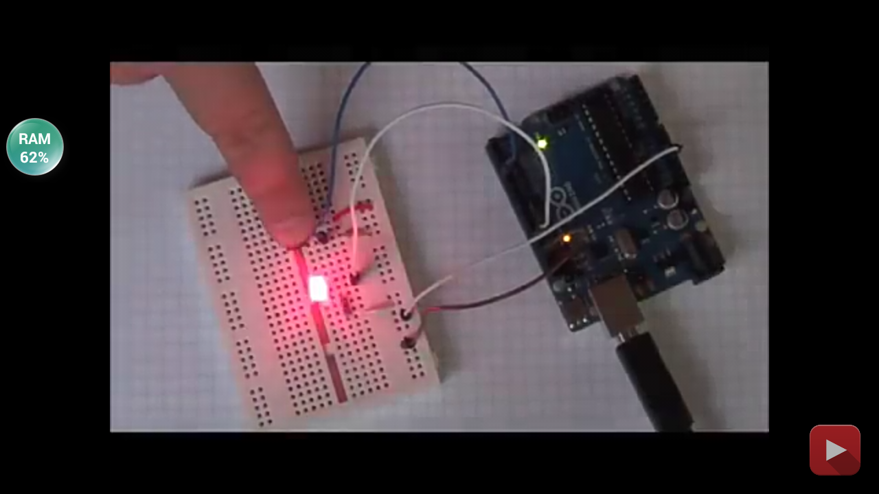
By pushing the button the lamp glow

